Slide 1


A Challenging Final on Classical Data Analysis
IL “Data and Decision Making” SS 26
Kami Höferl
(MervC, CC-BY-NC 2.0)

Slide 2
Overview
AMA 1. Assignment
Association is not Enough
A Litte Challange
(MervC, CC-BY-NC 2.0)
(Escher, 1961)

Slide 3
Bonus: Is my Metric Variable Normally Distributed?

Slide 4
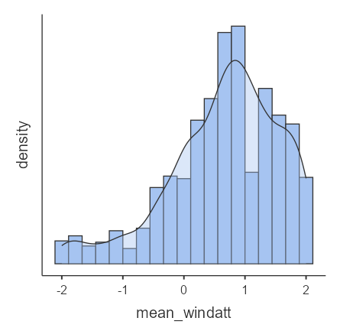
Let’s have a Look: Histogram & Density
Look for a bell-shaped curve
The curve should be symmetrical around the centre
The left and right tails should look similar
skewness = longer tail on one side
Most values should cluster around the mean
The curve should have one clear peak
NOT: Very flat or very peaked shape

Slide 5
Let’s have a Detailed Look: Kurtosis & Skewness
N | 1450
Missing | 0
Mean | 0.653
Median | 0.750
Skewness | -0.787
Kurtosis | 0.410
Shapiro-Wilk W | 0.949
Shapiro-Wilk p | <.001
Skewness:
👉 symmetry of a distribution
Indicates values are more spread out on one side
Skewness = 0 means perfectly symmetric
Positive skew = a longer tail on the right
Negative skew = a longer tail on the left

Slide 6
Let’s have a Detailed Look: Kurtosis & Skewness
N | 1450
Missing | 0
Mean | 0.653
Median | 0.750
Skewness | -0.787
Kurtosis | 0.410
Shapiro-Wilk W | 0.949
Shapiro-Wilk p | <.001
Kurtosis:
👉 shape and tail thickness
Indicates how heavy or light the tails are compared to a normal distribution
Normal distribution has a kurtosis value close to zero
High kurtosis = more extreme values & heavier tails
Low kurtosis = fewer extreme values & lighter tails

Slide 7
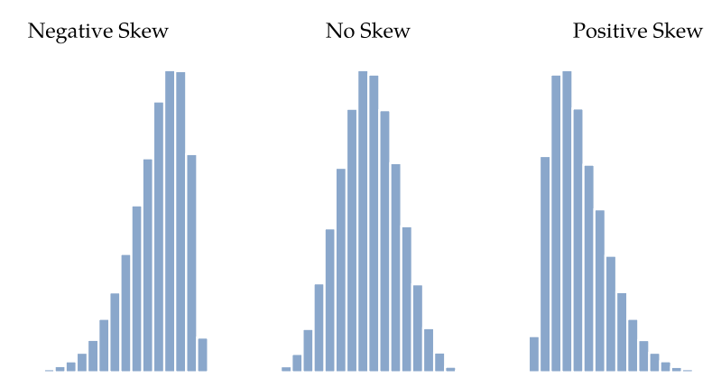
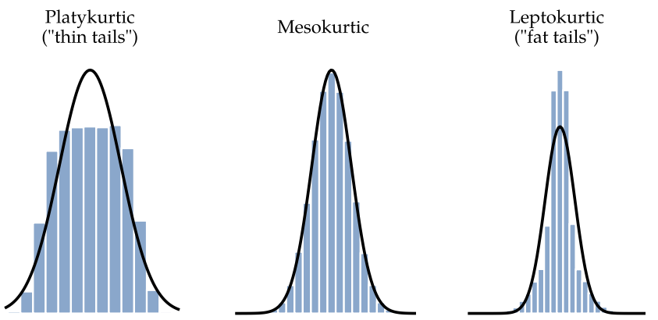
Let’s have a Detailed Look: Kurtosis & Skewness

Slide 8
The Lazy Way: The Shapiro-Wilk Test
Tests if dataset = approximately normally distributed
Compares the observed data distribution to a theoretical normal distribution
Null hypothesis H0: data is normally distributed
Alternative hypothesis H1: data is not normally distributed
👉 p-value:
p ≥ α → no evidence against normality
p < α → significant deviation from normality

Slide 9
The Lazy Way: The Shapiro-Wilk Test
N | 1450
Missing | 0
Mean | 0.653
Median | 0.750
Skewness | -0.787
Kurtosis | 0.410
Shapiro-Wilk W | 0.949
Shapiro-Wilk p | <.001
p-value:
p ≥ α → no evidence against normality
p < α → significant deviation from normality
P = < 0.001 👉
Drop Null Hypothesis H0
Data is not normally distributed

Slide 10
Sometimes Association is not Enough

Slide 11
Ordinal
Histogram Skewness/Kurtosis Shapiro-Wilk test
Metric
Non-Parametric methods
–
Normally distributed?
+
Parametric methods
Group comparisons
Correlation
Correlation
Group comparisons
Independent variable ordinal?
–
Inependent variable metric?
2 groups
more than 2 groups
+
+
Mann-Whitney U-Test
Kruskal Wallis Test
Post Hoc Tests
Spearmans Rho
Linear relationship?
more than 2 groups
–
2 groups
Variances homogeneous? Levene's test
+
+
+
–
Pearsons r
Linear regression
t-Test (homogen. Variances)
–
One-way analysis of variance (ANOVA)
Post Hoc Tests
–
Association
Contingency coefficient Phi
Cramer‘s V
t-Test Wilk (non-hom. Variances)
NOMINAL
Group comparisons
Non-parametric methods
Chi-square test

Slide 12
An Example:
🤔
Do men and women differ substantially in their average levels of conspiracy thinking?

Slide 13

Sometimes Association is not Enough
Ordinal
Histogram Skewness/Kurtosis Shapiro-Wilk test
Metric
Non-Parametric methods
–
Normally distributed?
+
BASIC ASSUMPTIONS: 1. Independent samples 2. Introduction: Scale level dependent variable
Parametric methods
Group comparisons
Correlation
Correlation
Group comparisons
Independent variable ordinal?
–
Independent variable metric?
2 groups
more than 2 groups
+
+
Mann-Whitney U-Test
Kruskal Wallis Test
Post Hoc Tests
Spearmans Rho
Linear relationship?
more than 2 groups
–
2 groups
Variances homogeneous? Levene's test
+
+
+
–
Pearsons r
Linear regression
t-Test (homogen. Variances)
–
One-way analysis of variance (ANOVA)
Post Hoc Tests
–
Association
Contingency coefficient Phi
Cramer‘s V
t-Test Wilk (non-hom. Variances)
NOMINAL
Group comparisons
Non-parametric methods
Chi-square test

Slide 14
Our Assumptions in Detail: Independent Samples
Independence: Each participant belongs to exactly one group, and their response is not influenced by other participants in the study
An Example: You compare stress levels between students in Vienna, Graz, and Salzburg. Each student lives in one city & students are not colluding when answering the survey 👉 independent sample
Notes:
Gegenteil: depentend sample
Paired: measured twiche with same person 2 x
repeated samples: more than 2 x

Slide 15
Our Assumptions in Detail: Dependent Variable
Dependent variable (DV): outcome you measure, characteristic of interest
Metric or ordinal scaling: Size, weight, etc.
Independent variable (IV): grouping variable
most often nominal scale: Gender, age, etc.
An Example: Do students in Vienna, Graz, and Salzburg differ in their stress levels?
DV: stress level
IV: Location (Vienna, Graz, and Salzburg)

Slide 16
The Kruskal-Wallis Test

Slide 17
Sometimes Association is not Enough
Ordinal
Histogram Skewness/Kurtosis Shapiro-Wilk test
Metric
Non-Parametric methods
–
Normally distributed?
+
BASIC ASSUMPTIONS: 1. Independent samples 2. Introduction: Scale level dependent variable
Parametric methods
Group comparisons
Correlation
Correlation
Group comparisons
Independent variable ordinal?
–
Independent variable metric?
2 groups
more than 2 groups
+
+
Mann-Whitney U-Test
Kruskal Wallis Test
Post Hoc Tests
Spearmans Rho
Linear relationship?
more than 2 groups
–
2 groups
Variances homogeneous? Levene's test
+
+
+
–
Pearsons r
Linear regression
t-Test (homogen. Variances)
–
One-way analysis of variance (ANOVA)
Post Hoc Tests
–
Association
Contingency coefficient Phi
Cramer‘s V
t-Test Wilk (non-hom. Variances)
NOMINAL
Group comparisons
Non-parametric methods
Chi-square test

Slide 18
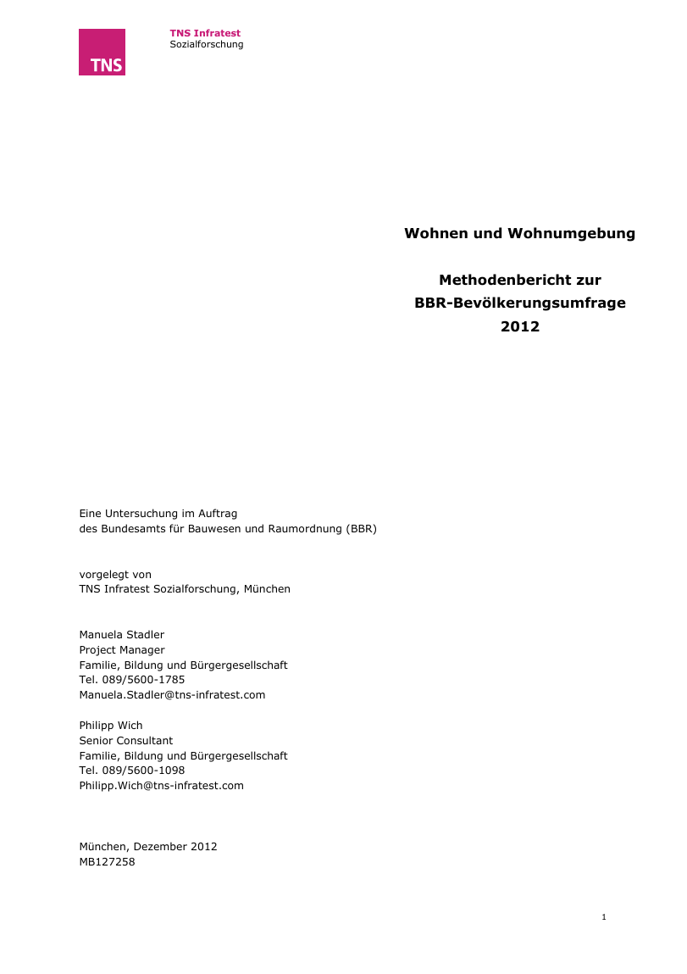
Comparing Group Differences
An Old-School-Example:
GESIS-Suche: LebensRäume - Bevölkerungsumfrage des BBSR 2012

Slide 19
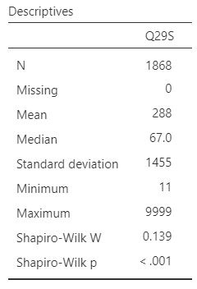
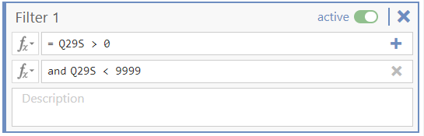
Comparing Group Differences
Before we begin: Some descriptives …

Slide 20
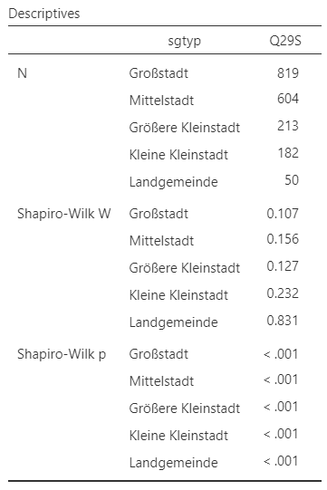
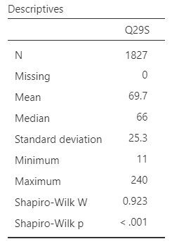
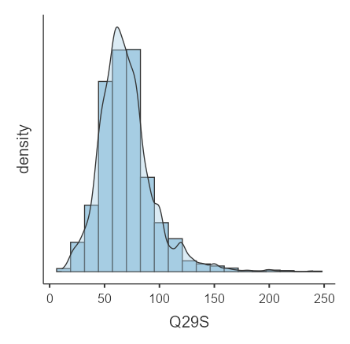
Comparing Group Differences
Is the flat size (Q29S) normally distributed in each region (sgtyp)?

Slide 21
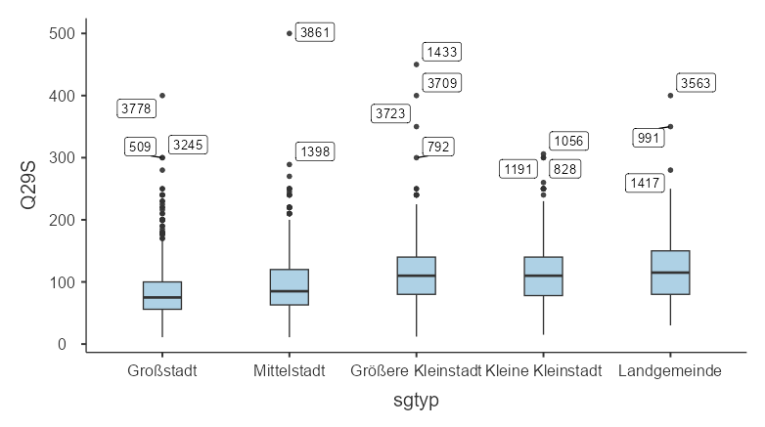
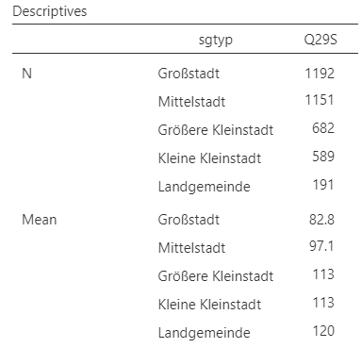
Comparing Group Differences
BSP: BBSR LebensRäume 2012 Differences in average flat size(Q29S) depending on the regional location (sgtyp)

Slide 22
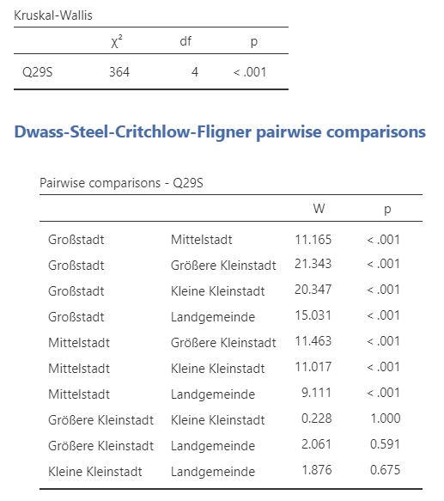
Comparing Group Differences
Interpretation:
H0: The average flat size is the same for each location type 👉 “The mean homogeneity hypothesis”
H1: … vary in size
p = 0.000 < α = 0,05
H0 is rejected (at a significance level of α = 0.05)
👉 significant differences in average flat sizes between regions

Slide 23
Comparing Group Differences
Interpretation:
H0: The average flat size is the same for each location type 👉 “The mean homogeneity hypothesis”
H1: … vary in size
p = 0.000 < α = 0,05
H0 is rejected (at a significance level of α = 0.05)
👉 significant differences in average flat sizes between regions 👉 Post-Hoc Test: Pairwise Comparisons

Slide 24
One-way analysis of variance (ANOVA)

Slide 25
Sometimes Association is not Enough
Ordinal
Histogram Skewness/Kurtosis Shapiro-Wilk test
Metric
Non-Parametric methods
–
Normally distributed?
+
BASIC ASSUMPTIONS: 1. Independent samples 2. Introduction: Scale level dependent variable
Parametric methods
Group comparisons
Correlation
Correlation
Group comparisons
Independent variable ordinal?
–
Independent variable metric?
2 groups
more than 2 groups
+
+
Mann-Whitney U-Test
Kruskal Wallis Test
Post Hoc Tests
Spearmans Rho
Linear relationship?
more than 2 groups
–
2 groups
Variances homogeneous? Levene's test
+
+
+
–
Pearsons r
Linear regression
t-Test (homogen. Variances)
–
One-way analysis of variance (ANOVA)
Post Hoc Tests
–
Association
Contingency coefficient Phi
Cramer‘s V
t-Test Wilk (non-hom. Variances)
NOMINAL
Group comparisons
Non-parametric methods
Chi-square test

Slide 26
Again: Comparing Group Differences II
Often: dependent variable not normally distributed in its groups
An example:
eh4_flat_size_dataset.csv 👉 on Teams (Folder: “Data”)
sgtyp: ordinally scaled regional location of a flat
flat_size: in m²
sgtyp;flat_size
Großstadt;62.5
Großstadt;52.9
Großstadt;64.7
Großstadt;77.8
Großstadt;51.5
Großstadt;51.5
Großstadt;78.7
Großstadt;66.5
Großstadt;48.0
Großstadt;63.1
Großstadt;48.0
Großstadt;48.0
Großstadt;58.6
Großstadt;26.3
Großstadt;29.1
Großstadt;46.6
Großstadt;39.8
Großstadt;59.7
Großstadt;41.4
Großstadt;33.8
Großstadt;77.0
Großstadt;51.6
Großstadt;56.0
Großstadt;33.6
Großstadt;46.8
Großstadt;56.7
Großstadt;37.7
Großstadt;60.6
Großstadt;46.0
Großstadt;50.6
Großstadt;46.0
Großstadt;82.8
Großstadt;54.8
Großstadt;39.1
Großstadt;67.3
Großstadt;36.7
Großstadt;58.1
Großstadt;25.6
Großstadt;35.1
Großstadt;58.0
Großstadt;66.1
Großstadt;57.6
Großstadt;53.3
Großstadt;50.5
Großstadt;32.8
Großstadt;44.2

Slide 27
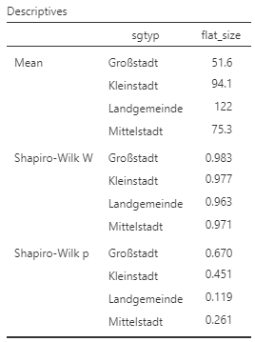
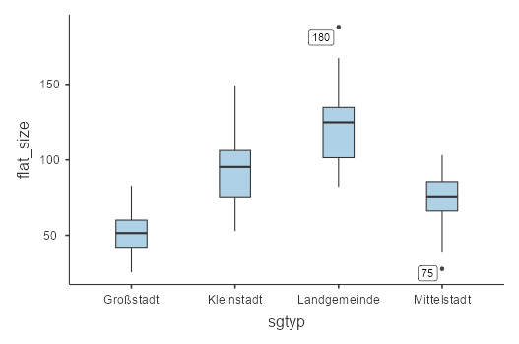
Comparing Group Differences II

Slide 28
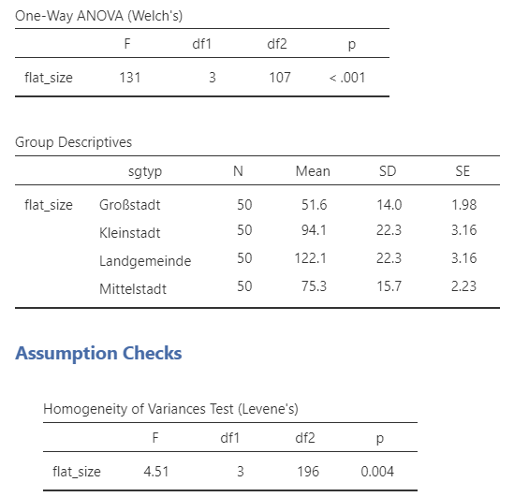

Comparing Group Differences II
Levene Test for homogeneity of variance
H0: All groups have equal variances.
H1: At least two groups differ in their variance
If p ≤ α 👉 H0 is rejected 👉 no homogeneity of variance 👉

Slide 29
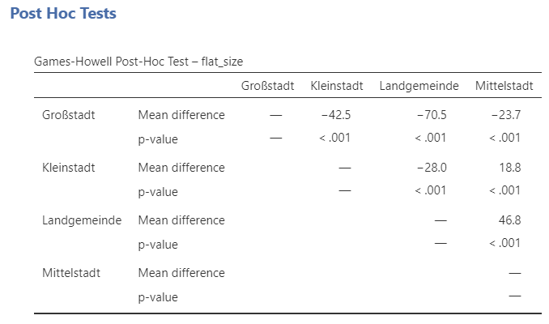
Comparing Group Differences II

Slide 30
Welcome …

Slide 31

… to the Ultimate:

Slide 32


Slide 33
I know: Sad but True 😉

Slide 34
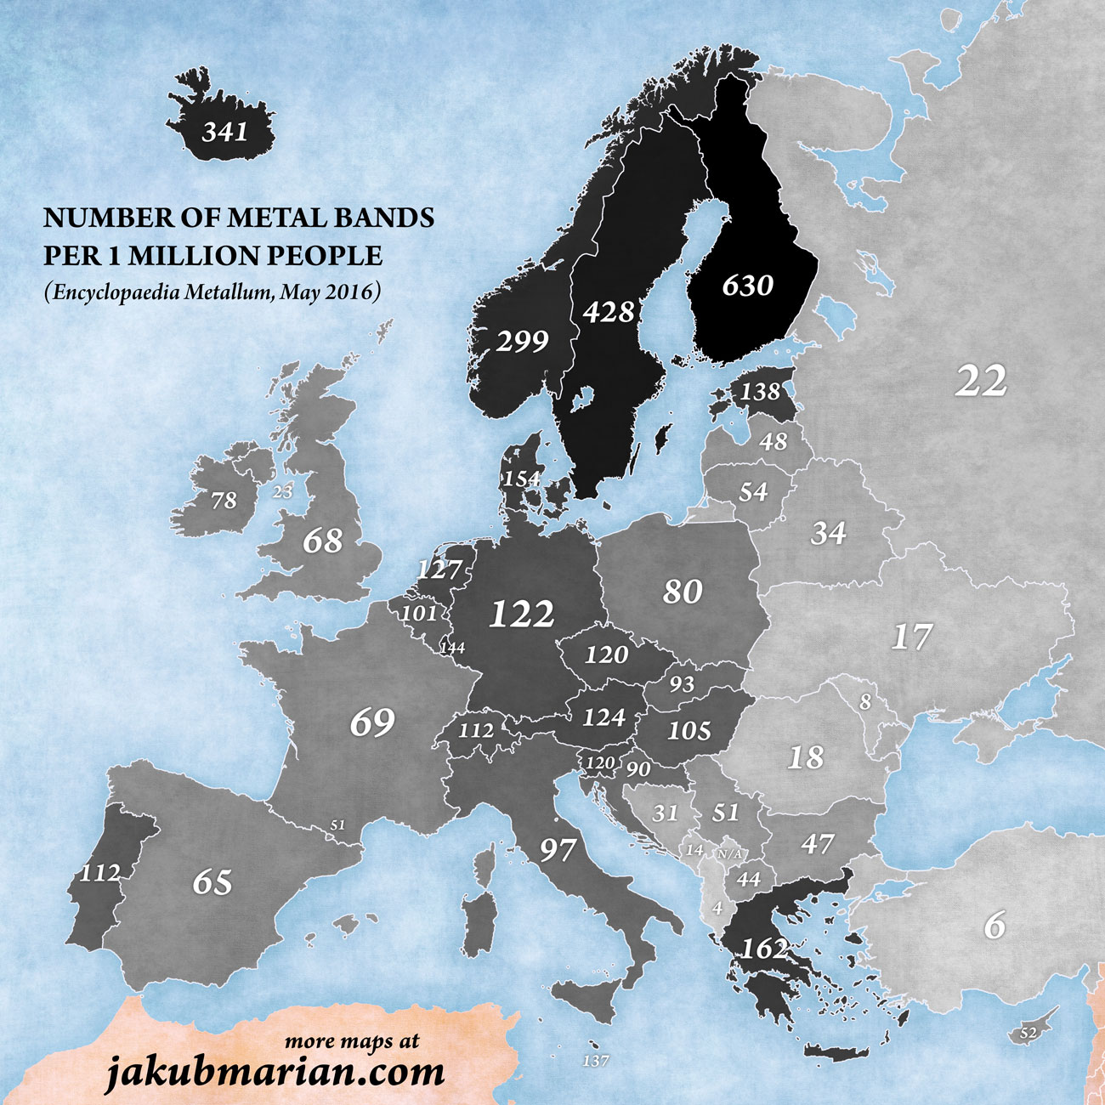
Why Heavy Metal?

Slide 35

Why Heavy Metal?
🤔 Why There? 🤔
🤔
🤔
💡💡💡
… not much daylight …
… dark …
👉 making the best of it

Slide 36

We are not the Only Ones
DeHart, C. (2018). Metal by numbers: Revisiting the uneven distribution of heavy metal music. Metal Music Studies, 4, 559–571. https://doi.org/10.1386/mms.4.3.559_1

Slide 37

So: Let’s Push the Boundary of Knowledge
Research Question: Is there a connection between the Metal Band Density (MBD) and the amount of sunlight in various nations?

Slide 38
Ninja your Way Through
Operationalise Metal Band Density (MBD)
Number of metal bands per country
Population number per country
Operationalise amount of sunlight
Number of sunny hours per …
Operationalise “connection”

Slide 39
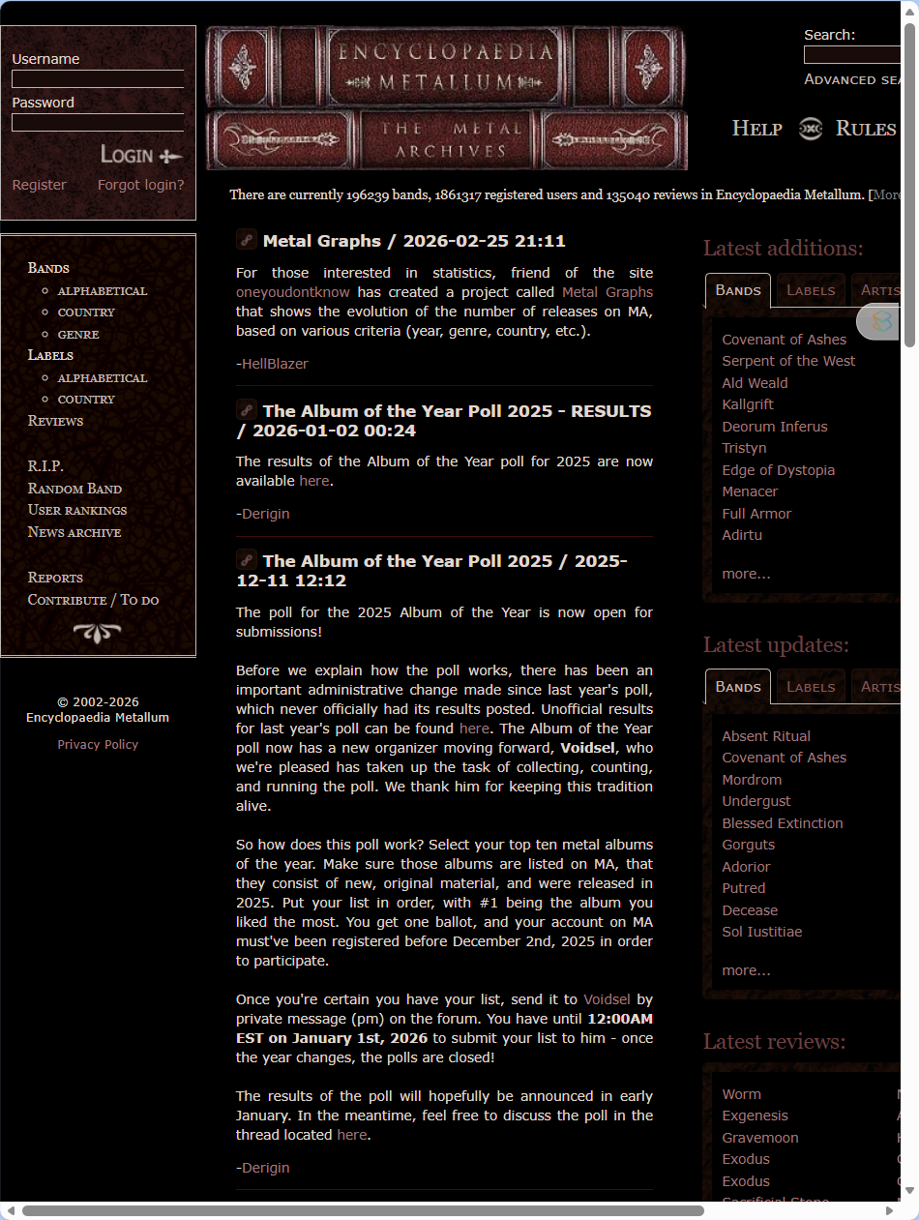
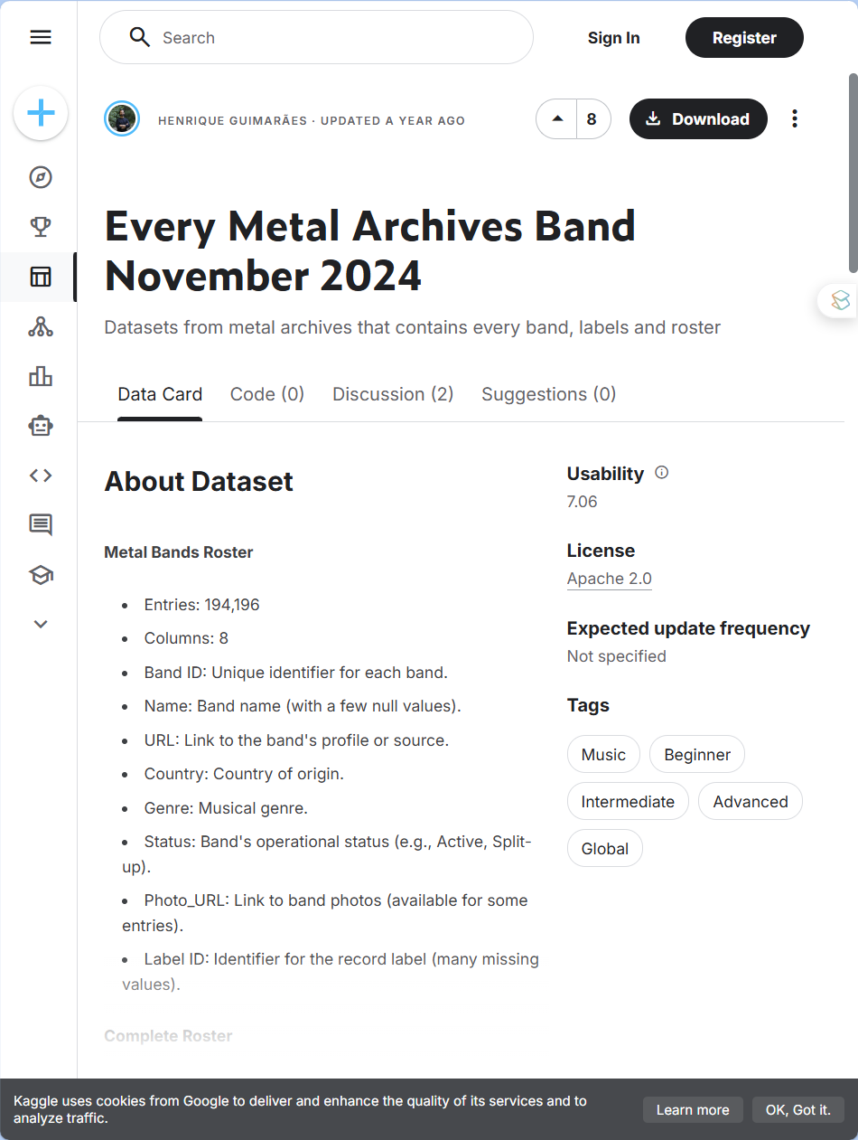
A Litte Hint:
https://www.kaggle.com/datasets/guimacrlh/every-metal-archives-band-october-2024

Slide 40
A Suggestion
Phase 1 (0–20 min) Framing & Strategy: Define MBD and sunlight ↔ scout out data
agree on countries & data sources, plan the workflow
Phase 2 (20–80 min) Data Collection & Preparation:
Gather band counts (Metal Archives), sunshine data, and population figures
Harmonize units, align country names, handle missing values, build a joint dataset
Phase 3 (80–110 min) Analysis & Visualisation: identify & handle outliers, create scatter plot, calculate correlation
Phase 5 (110–130 min) Comparison of Results & Reflection: Present findings, discuss correlation vs causation and limitations

Slide 41
Let’s Rock!

Slide 42
Outlook

Slide 43
Outlook
XXX

Slide 44
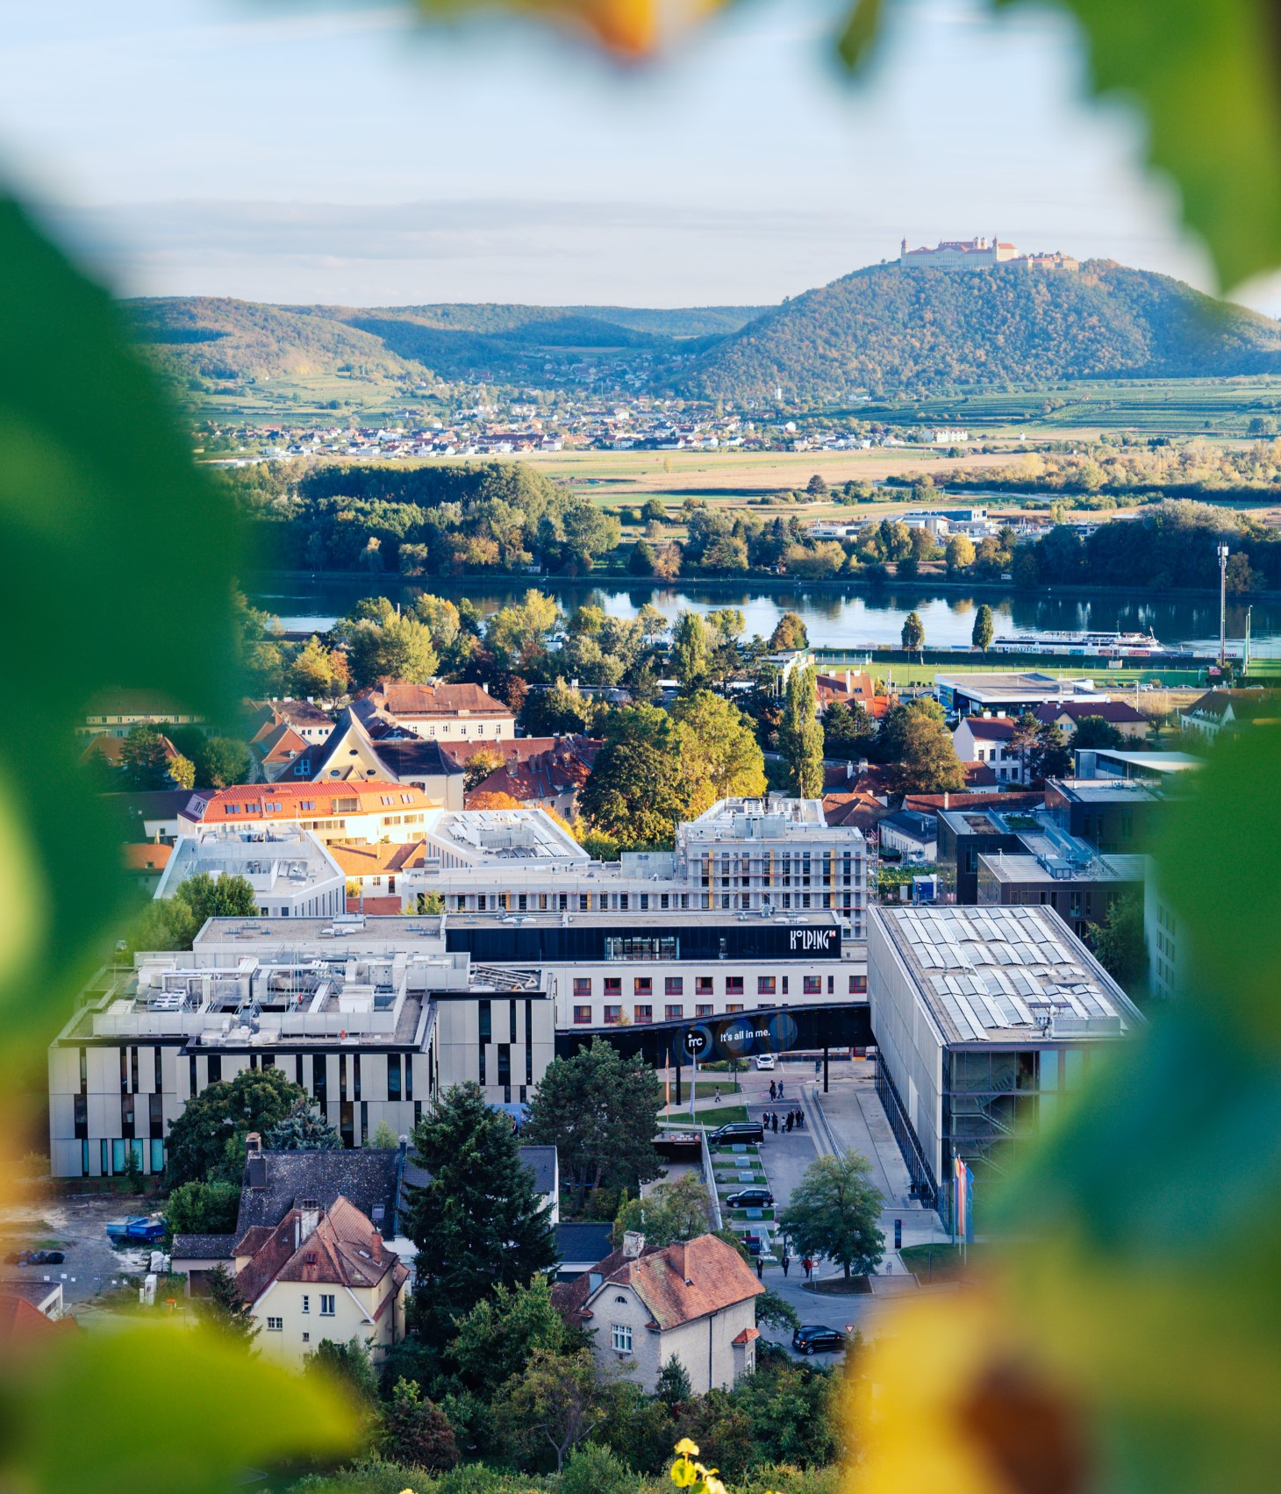

So long & cheerio!

